Slide 1
Software Security
CSC 481/681/781
Principles of Computer Security
Ref: Textbook, Section 3.4

Slide 2
Static Analysis Basic idea
Traditional methods of finding errors:
testing
code inspection
Security errors can be hard to find by these methods, because they
only arise in unusual circumstances
- particular inputs uncommon execution paths, ...
code base is too large for a human code inspection

Slide 3
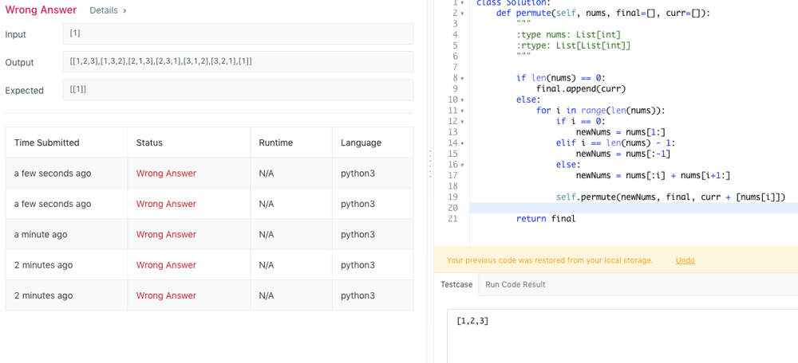
Static Analysis Basic idea

Slide 4
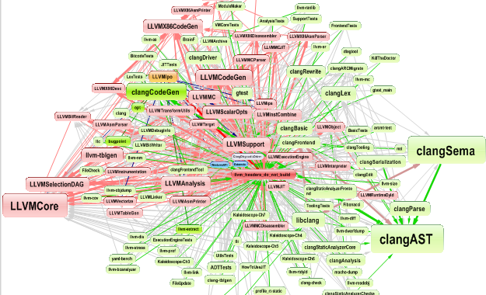
Static Analysis Basic idea

Slide 5
Static Analysis Basic idea
Traditional methods of finding errors:
testing
code inspection
Security errors can be hard to find by these methods, because they
only arise in unusual circumstances
- particular inputs uncommon execution paths, ...
code base is too large for a human code inspection
Here static analysis can provide major improvement

Slide 6
Static Analysis
Basic idea
Programmers reason about security and find bugs…
… could a program do the same reasoning?
Static analysis refers to tools for automated analysis of software
Two fundamental concepts
Abstraction
Elide details of a specific implementation.
Capture semantically relevant details; ignore the rest.
Programs as data
Programs are just trees/graphs!
…and CS has lots of ways to analyze trees/graphs

Slide 7
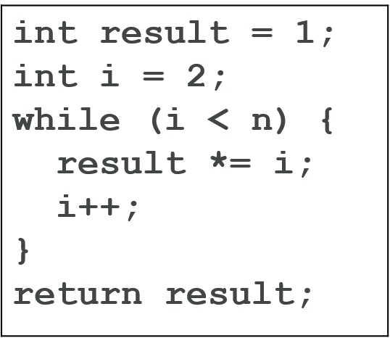
Static Analysis
Basic idea
Program
=
…
while
result
1
<
block
i
n
…

Slide 8
Static Analysis
Basic idea
Why might it be hard to test/inspect for:
Array bounds errors?
Test input:
i = 0, 1, 5, 9 → all OK
i = 10 → crash (out of bounds)
char buf[10]; buf[i] = 'A';
If your test never uses i = 10, you miss it.

Slide 9
Static Analysis
Basic idea
Why might it be hard to test/inspect for:
Forgetting to re-enable interrupts?
disable_interrupts(); /* critical section */ if (error) return;
enable_interrupts();
OOPS: interrupts never re-enabled
The system may work fine most of the time… until it suddenly freezes.

Slide 10

Static Analysis
Basic idea
Why might it be hard to test/inspect for:
Race conditions?
if (balance >= 100) { balance -= 100; }
Two threads execute this simultaneously.
You need the exact timing to trigger the bug.

Slide 11
Vulnerability: Race Condition
Idea
Typical code sequence:
Check a condition
Do some stuff
Perform an operation that depends on check in 1.
Check
Condition
Dependent
Action
Can attacker change condition?
(Window of vulnerability)

Slide 12
Vulnerability: Race Condition
Example
Common situation: Rights to an object checked, then used
CWE-367: Time-of-check Time-of-use (TOCTOU) race condition
Example in a Set-UID program:
access() call - checks for access using real (not effective) uid
Determines if user permissions (not elevated permission) allow access
if (access(filename, W_OK) == 0) {
if ((fd = fopen(filename, O_WRONLY)) == NULL) {
perror(filename);
return 0;
}
/* now write to the file */
...
Between access() and fopen(), attacker replaces with symbolic link to system file

Slide 13

Static Analysis
Some types of static analyzers:
Lexical: Parses code and looks for dangerous patterns
Find use of dangerous functions (compiler warnings), missing error checks, ...
Sometimes called a “linter” after classical C tool named “lint”
Tools: flawfinder, cppcheck, splint, …
Parse the code
Look for:
Dangerous functions
Missing checks
Bad coding patterns
gets(buf); // flagged immediately

Slide 14
Static Analysis
Some types of static analyzers:
Symbolic execution: Traces paths through code with symbolic values
Can do path-sensitive discovery - but exponentially many paths!
Tools: clang static analyzer, KLEE

Slide 15
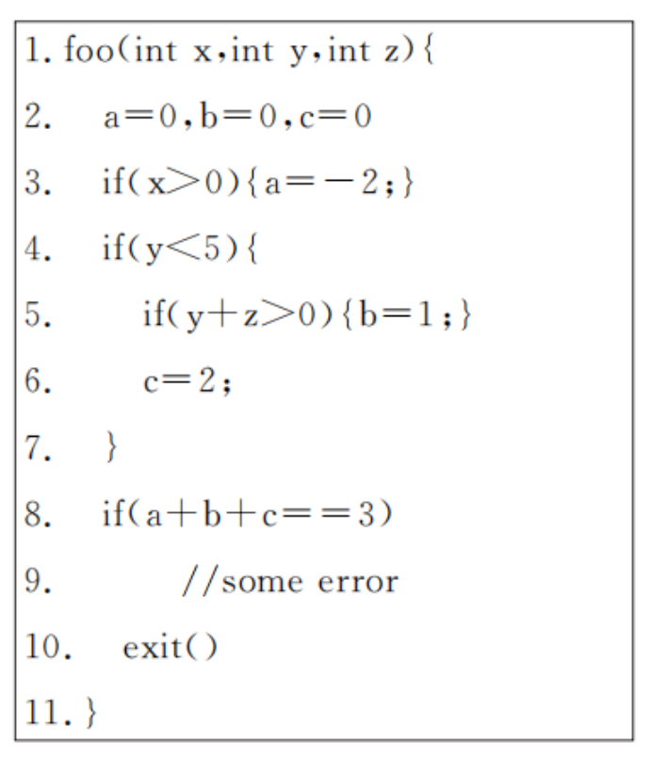
Static Analysis
Symbolic execution:

Slide 16
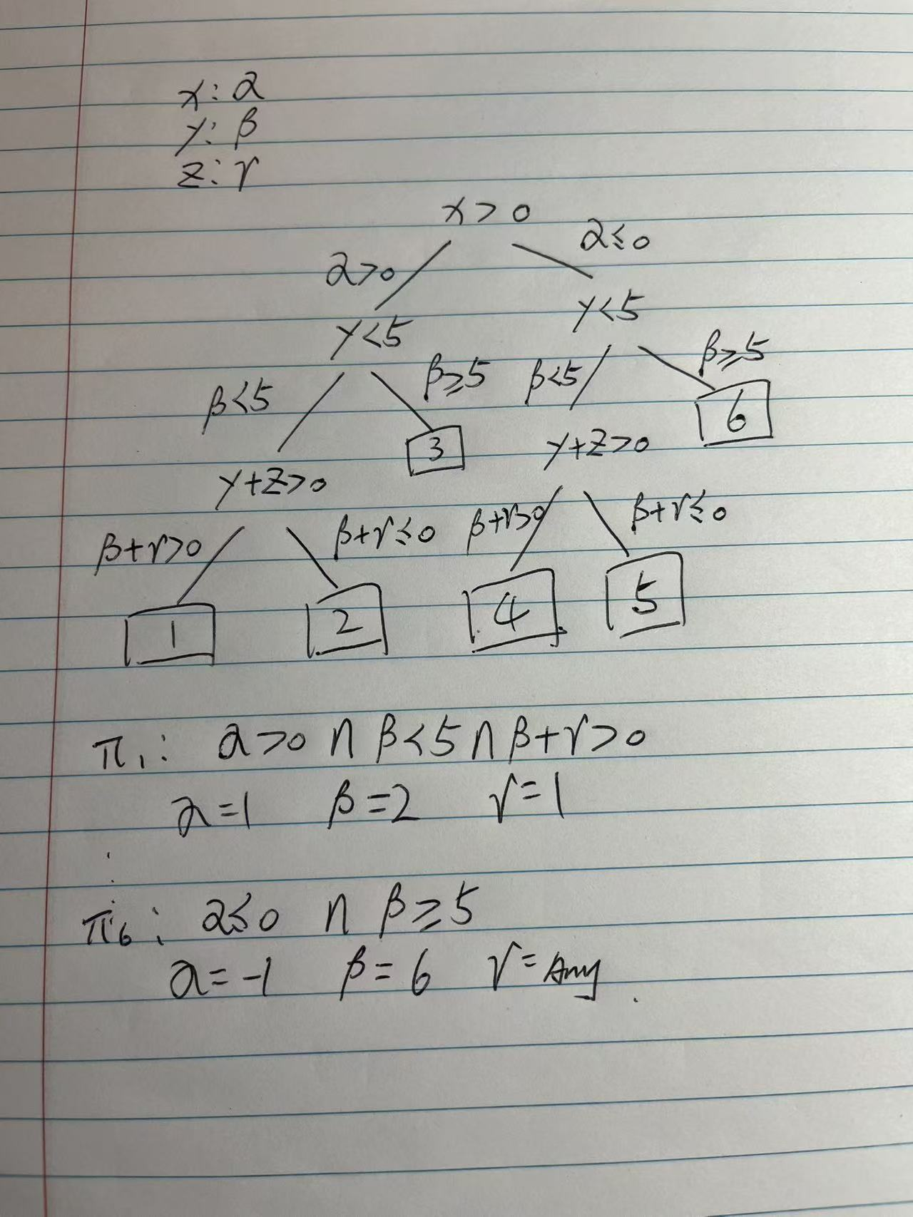
Static Analysis
Symbolic execution:

Slide 17
Static Analysis
Dataflow analysis:
Number of possible states gigantic：
n 32 bit variables results in 2^{32*n} states： 2^{(32*3)} = 2⁹⁶
With loops, states can change indefinitely
Zero Analysis narrows the state space
Zero or not zero: 2³ = 8
When this limited space is explored, then we are done
Extrapolate over all loop iterations

Slide 18
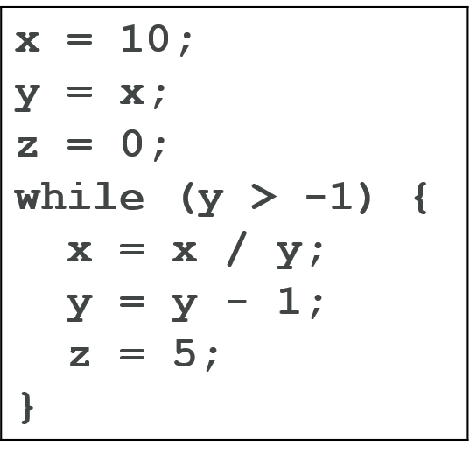
Static Analysis
Dataflow analysis example :
Use zero analysis to determine if x is ever 0.

Slide 19
Static Analysis
x = 10
y = x
Dataflow analysis example :
z = 0
y > -1
x = x / y
y = y - 1
z = 5
(exit)

Slide 20
x = 10
x:NZ
y = x
x:NZ, y:NZ
z = 0
x:NZ, y:NZ, z:Z
y > -1
x:NZ, y:NZ, z:Z
x:NZ, y:MZ, z:MZ
x:NZ, y:MZ, z:MZ
x = x / y
x:NZ, y:NZ, z:Z
x:NZ, y:MZ, z:MZ
x:NZ, y:MZ, z:MZ
y = y - 1
x:NZ, y:MZ, z:Z
x:NZ, y:MZ, z:MZ
x:NZ, y:MZ, z:MZ
z = 5
x:NZ, y:MZ, z:NZ
x:NZ, y:MZ, z:NZ
x:NZ, y:MZ, z:MZ
(exit)

Slide 21
x = 10
x:NZ
y = x
x:NZ, y:NZ
z = 0
x:NZ, y:NZ, z:Z
y > -1
x:NZ, y:NZ, z:Z
x:NZ, y:MZ, z:MZ
x:NZ, y:MZ, z:MZ
x = x / y
x:NZ, y:NZ, z:Z
x:NZ, y:MZ, z:MZ
x:NZ, y:MZ, z:MZ
y = y - 1
x:NZ, y:MZ, z:Z
x:NZ, y:MZ, z:MZ
x:NZ, y:MZ, z:MZ
z = 5
x:NZ, y:MZ, z:NZ
x:NZ, y:MZ, z:NZ
x:NZ, y:MZ, z:MZ
(exit)
Example final result: x:NZ, y:MZ, z:MZ

Slide 22
Static Analysis
int foo() {
Integer x = new Integer(6);
Integer y = bar();
int z;
if (y != null)
z = x.intVal() + y.intVal();
else {
z = x.intVal();
y = x;
x = null;
}
return z + x.intVal();
}
Test your understanding
Are there any possible null pointer exceptions in this code?

Slide 23
Static Analysis
Integer x = new Integer(6);
int foo() {
Integer x = new Integer(6);
Integer y = bar();
int z;
if (y != null)
z = x.intVal() + y.intVal();
else {
z = x.intVal();
y = x;
x = null;
}
return z + x.intVal();
}
Integer y = bar();
Test your understanding
int z;
if (y != null)
z = x.intVal();
y = x;
x = null;
z = x.intVal() + y.intVal();
return z + x.intVal();

Slide 24
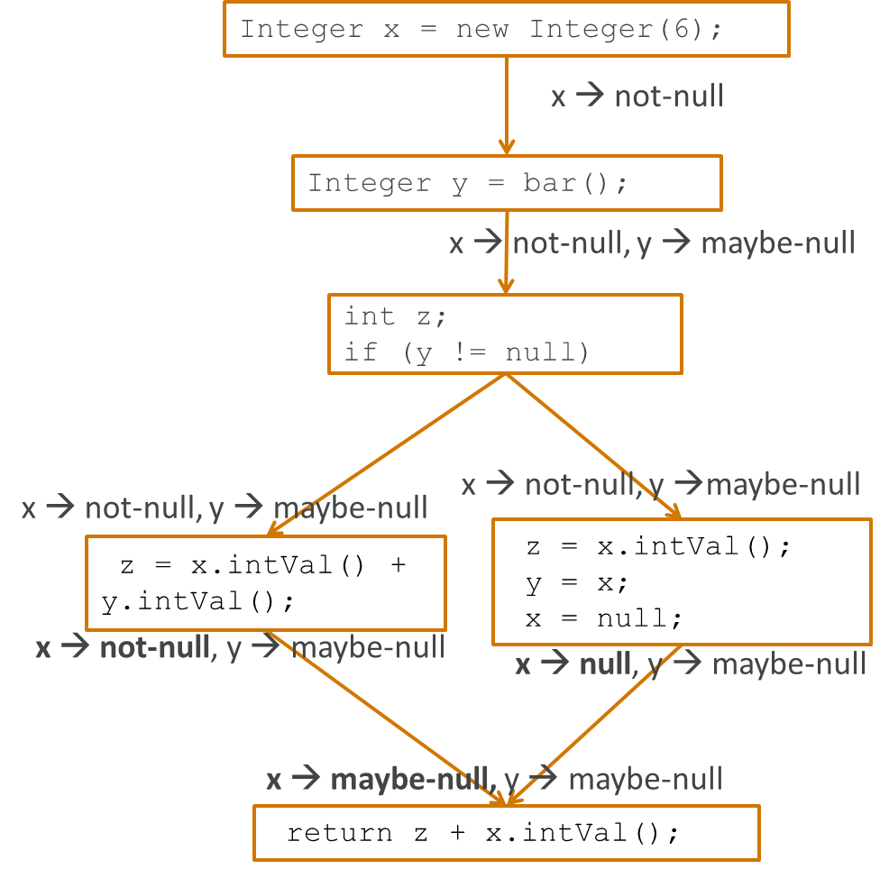
Static Analysis
int foo() {
Integer x = new Integer(6);
Integer y = bar();
int z;
if (y != null)
z = x.intVal() + y.intVal();
else {
z = x.intVal();
y = x;
x = null;
}
return z + x.intVal();
}
Test your understanding

Slide 25
Static Analysis - Foundations
Limitations to What is Possible
Henry Gordon Rice’s Theorem: "Any nontrivial property about the language recognized by a Turing machine is undecidable.“
What do all these terms mean?
“non-trivial property” - a property that isn’t always true or always false
“undecidable” - no algorithm can decide (whether the property is true or false) in all cases - impossible, not just a matter of efficiency!
A programming language wording (courtesy of Wikipedia): “There exists no automatic method that decides with generality non-trivial questions on the behavior of computer programs.”
Consequence: No analysis tool can be written that can definitively tell whether or not an arbitrary program has a buffer overflow.

Slide 26
Static Analysis - Foundations
Limitations to What is Possible
Rice’s Theorem (see the Theory of Computing textbook!): Every non-trivial property of the r.e. sets is undecidable.
What do all these terms mean?
“the r.e. sets” - can think of this as “programs”
“non-trivial property” - a property that isn’t always true or always false
“undecidable” - no algorithm can decide (whether the property is true or false) in all cases - impossible, not just a matter of efficiency!
A programming language wording (courtesy of Wikipedia): “There exists no automatic method that decides with generality non-trivial questions on the behavior of computer programs.”
Consequence: No analysis tool can be written that can definitively tell whether or not an arbitrary program has a buffer overflow.
Important point: We’re talking about behavior of the program when it is run, not a property of the source code representation (“Is the program properly indented?” is certainly decidable).

Slide 27
Static Analysis - Foundations
What Rice’s Theorem Doesn’t Say
Consequence: No analysis tool can be written that can definitively tell whether or not an arbitrary program has a buffer overflow.
Let’s explore what this means a little bit:
It doesn’t say that a tool can’t find any buffer overflows
It doesn’t say that a tool can’t find the majority of buffer overflows
It doesn’t say that no programs can be proved free of buffer overflows
Example: A program written in Python can be proven to have no integer overflows. How does Rice’s Theorem apply?
All it says is that for any analysis tool, you can create a program that it will not be able to analyze.
int main() {
int buffer[4];
if (unanalyzable_boolean_function())
buffer[5] = 0;
return 0;
}
Does this program have a buffer overflow?

Slide 28
Static Analyzers
Good and useful analyzers are possible!
“The perfect is the enemy of the good.” - Voltaire
(A slight mistranslation of “le mieux est l'ennemi du bien”, but commonly stated this way in English)
Static Analysis tools:
A tool is sound if it finds all possible errors/vulnerabilities (of whatever type it is looking for), but may also report some false positives.
A tool is complete if every reported error is a real error (i.e., no false positives), but it might miss some (false negatives).
Rice’s Theorem says a tool cannot be both sound and complete.
Most tools (all commonly used ones?) are neither - but are still useful!
Typically: Large numbers of false positives are difficult to deal with.

Slide 29
Static Analyzers
Some free tools
There are a LOT of static analyzers. A few of note for C/C++:
Some free tools (see also https://dwheeler.com/essays/static-analysis-tools.html):
flawfinder (https://www.dwheeler.com/flawfinder/index.html)
Basically a pattern-matcher for dangerous coding
Good part: Latest version coordinated with CWE codes
cppcheck (https://cppcheck.sourceforge.io/)
Does checks for out-of-bounds errors, memory leaks, uninit variables, unsafe function usage, …
Both a stand-alone tool and integrated into Eclipse, Visual Studio, gedit, some version control systems (git, SVN, and mercurial), and more
clang static analyzer (https://clang-analyzer.llvm.org/)
Open source project originally from Apple.
Built on top of the LLVM compiler infrastructure, for C, C++, and Objective C.
Stand-alone tool and integration into XCode
97 different tests with version 3.6 distribution
Nice HTML-formatted reports
clang and cppcheck examples

Slide 30
Static Analyzers
Some commercial tools
HP Fortify
“HP Fortify Static Code Analyzer helps verify that your software is trustworthy, reduce costs, increase productivity and implement secure coding best practices. Static Code Analyzer scans source code, identifies root causes of software security vulnerabilities and correlates and prioritizes results—giving you line–of–code guidance for closing gaps in your security. To verify that the most serious issues are addressed first, it correlates and prioritizes results to deliver an accurate, risk–ranked list of issues.”
Coverity
“The Coverity® Code Advisor solution includes Coverity Quality Advisor and Coverity Security Advisor. The solution surfaces quality and security defects in the developer workflow, with accuracy and actionable remediation guidance.”
PVS-Studio
“The PVS-Studio tool is intended for developers of contemporary applications and it integrates into the Visual Studio 2013, 2012, 2010, 2008, 2005 environments providing the programmer with a convenient user interface to analyze files, navigate through code and get reference information. You do not need to study documentation and settings preliminarily to work with the analyzer. The analyzer is ready to work right after it is installed.”

